Slide 1
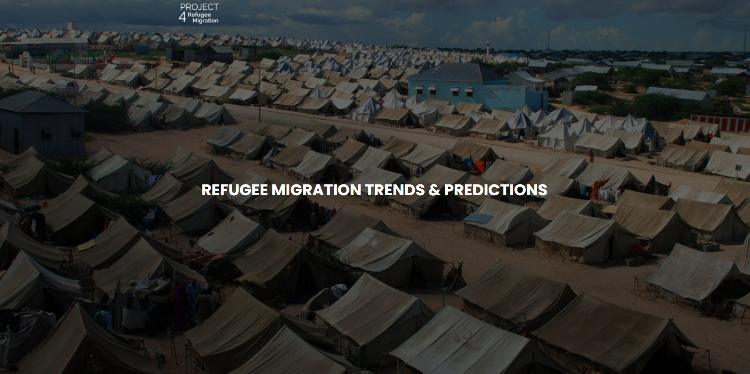

Slide 2
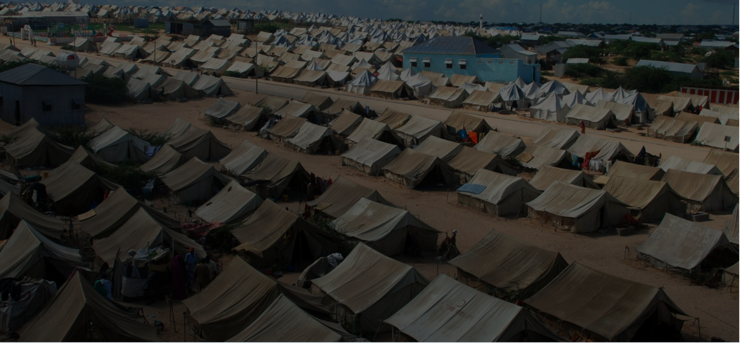
Project Summary:
Our project aims to analyze data provided by the UN Refugee Agency to gain insights into refugee migrations patterns and to develop a machine learning model that can predict the number of refugees in future migration flows. The data includes information on refugee populations, demographic, asylum decision, conflict and disasters. We hope to gain a deeper understanding of the factors that influence migration flows and develop predictions of future migration patterns.

Slide 3
Data Sources:
Our data sources show conflict and disaster are the two major types of refugee populations. Another data source with demographic data to show age and gender refugee information
Refugee Demographic Data - The United Nations Refugee Agency (UNHCR ) collects data on refugee’s around the world - https://www.unhcr.org/refugee-statistics/download/?url=Kg1Mg6
Conflict Data - Uppsala Conflict Data Program - Department of Peace and Conflict Research - https://ucdp.uu.se/
Disaster Data - Centre for Research on the Epidemiology of Disasters - https://www.emdat.be/

Slide 4
Data Limitations:
Data standardization: The use of different methods for counting refugee populations, which can make it difficult to compare data across different sources. For example, some organizations may use different definitions of "refugee" or "asylum seeker," which can lead to confusion and inconsistencies in data analysis.
Bias: Not all refugees live in informal settlements. Therefore, those who live outside of refugee’s camps might not be represented in the data collection.
Limited access to data on conflict: Affected areas in eastern Ukraine due to security concerns and restrictions on movement.
Time sensitivity: Turkey Earthquake challenges in collecting accurate data on the number of casualties and damage to infrastructure in the immediate aftermath of the earthquake due to limited access and time sensitivity.
Lack of historical data: Limited access to data on conflict affected areas in Ukraine and challenges in collecting accurate data on the number of casualties and damage to infrastructure in Turkey Earthquake.

Slide 5
Data Cleaning:
The data cleaning process involved identifying missing data, correcting inconsistencies, removing duplicates, irrelevant data, standardizing and scaling the data. The resulting cleaned dataset was suitable for further analysis and can be used to gain insights into the patterns, trends and future prediction of refugee migration.

Slide 6
SQLite Database
Created 4 SQLite tables to store and retrieve the data. Created a database schema with primary and secondary keys and documented the schema in Quick Database Diagrams application.
Tables:
Table 1 -Demographic_ml
Table 2 – Event_ml
Table 3- Cleaned_conflict
Table 4 –Cleaned_disasters

Slide 7
Tableau Metrics & Maps:
Created 4 areas of focus to capture the refugee metrics and to show countries with the greatest impacts from conflicts or disasters.
Observation 1:
The Demographic graphs demonstrates the ages, gender and overall volume of the refugee
Observation 2:
This map shows the countries with the greatest impacts from conflicts and disasters.
Observation 3:
The graphic shows the migration of immigrants from the top 20 most impacted countries. The migration is represented by the “Source” and “Target” countries.

Slide 8
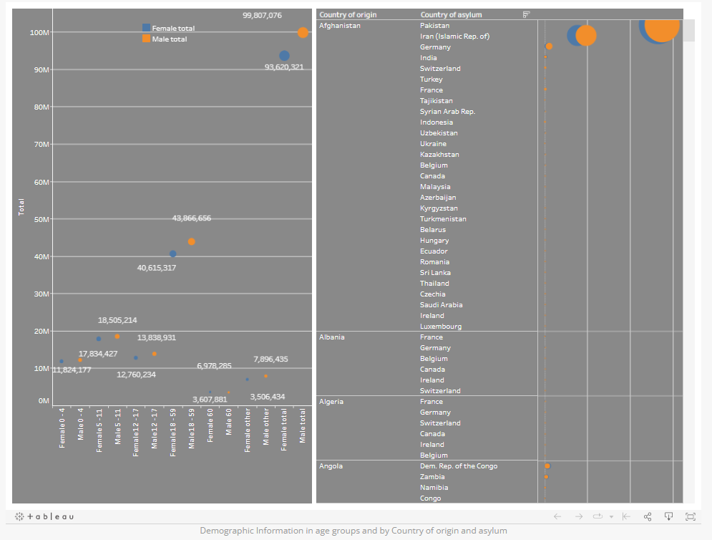
Observation 1 Demographics:

Slide 9
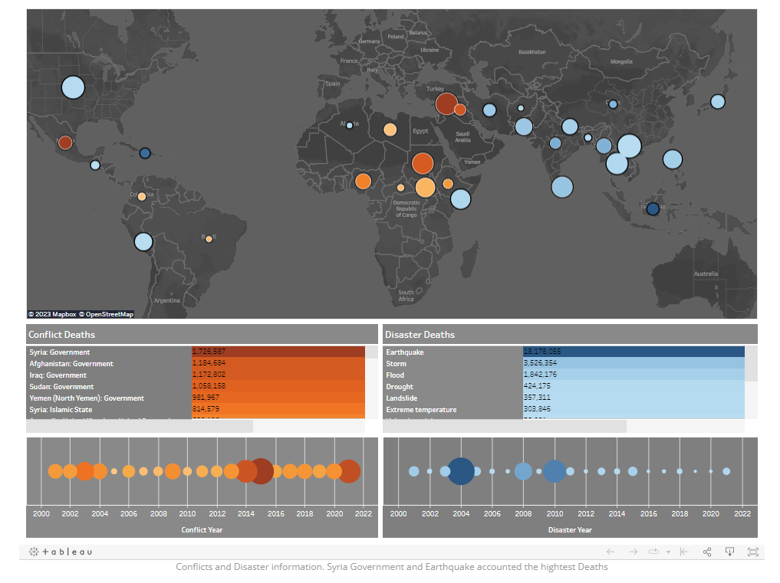
Observation 2 Conflict & Disaster:

Slide 10
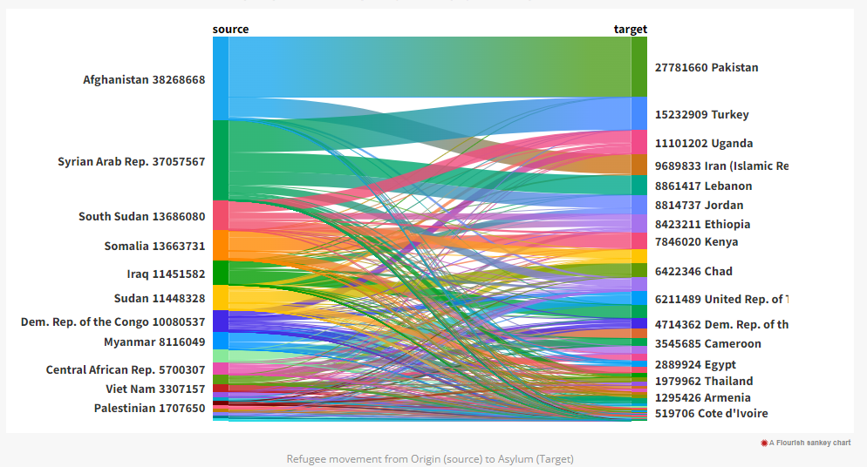
Observation 3 Refugee Movement:

Slide 11
Web Design:
We used HTML and CSS to design the site and a highlight able navigation bar to navigate to different pages of the website. For the graphical representations we embedded Tableau slides to demonstrate our data.

Slide 12
Machine Learning:
Out machine learning was in sections highlighted below.
Loading the cleaned data
Used OneHot Encoder to transform the data
Trained and scaled the data
Used Linear Regression for the first regression model
Used Random Forest Regression for the second regression model
Used “model.predict” to make our prediction

Slide 13
Thank you!
Questions?

